Slide 1
Expert Meeting - Mining Community Development Agreements
Problems and Issues to Overcome
10 June 2011
Hotel Caransa
Amsterdam
Luke Danielson
Sustainable Development Strategies Group
www.SDSG.org

Slide 2
THE OBJECTIVE (1)
The objective seems clear – to meet the need of humans
for natural resources in ways that are consistent with
principles of sustainable development, which include these:
Ensuring that the impacts of production do not reduce the flow of ecosystem benefits to the most impacted people and communities; and
Ensuring that the most impacted people and communities achieve development benefits from resource extraction

Slide 3
THE OBJECTIVE (2)
The process will not work if the objective is seen as landing material benefits on people. A cell phone tower or a refrigerator is not development.
More and better options for the future, and more power to define and choose the future path need to be the goal. Amartya Sen, Development as Freedom.

Slide 4
ROLES AND RESPONSIBILITIES
What is the role of national government?
What is the role of local government?
What is the role of resource companies?

Slide 5
NATIONAL GOVERNMENT – A TRADITIONAL VIEW
One traditional view of the development process is that since minerals belong to the central state, the fundamental way that they can be used for development is through payment of taxes by the developer to the national government.
The national government then uses these revenues to promote development. The national government decides whether there is a local share, how much that local share is, and what it is spent on.
The area where the project is located has no special call on these tax resources.

Slide 6
WHY HAS THIS VIEW BEEN ABANDONED?
This view has largely been abandoned, because it
simply does not work:
It presumes that there are tax revenues, when too often there are not;
It presumes that revenues come at a time that matters, when they almost never do;
It ignores the important reasons why impacted communities actually do have a ‘special right’ or call on some of the revenue;
Resource companies generally hate it; and
It is a key cause of violence, conflict, and project failure.

Slide 7
THE NATIONAL ROLE
National government plays an extremely important role in development. Resource production must be good for national governments, and support national development.
But the idea that impacted local communities can be sacrificed for the ‘greater good’ of the nation state is inconsistent with sustainable development.
Both have to benefit and advance; the precise formula for sharing benefits between national government and impacted regions has to be worked out in each case.
Guidance in this area is really vague. The Resource Charter (P12) says no more than that there should be “engagement with governments and communities to ensure the delivery of benefits…”

Slide 8
A MODEL OF NATIONAL – LOCAL SHARING
Adjusting the balance between national ownership and control of resources and the local claim to a share may be the most critical issue in turning resources into sustainable development
But the great economic thinkers seem to say almost nothing useful about it.
Increasing local control over the terms of development may be the most critical element in keeping resource development within ecosystem limits – few are likely to make their own back yards into ecological ‘sacrifice zones.’

Slide 9
NATIONAL – LOCAL TENSIONS
May be at their most difficult where there are racial, ethnic, cultural or historic differenced between those who dominate national government and local populations.
Grasberg , Darfur, Ogoniland, Aceh….
“If they get any revenues, they will use them to buy arms and secede.”
Even where it is managed peacefully through the political process, tension between central governments on one hand and provinces, states, regions and communities on the other is a fact of life.
Community Development Agreements are useful where they help manage these tensions

Slide 10
WHAT IS THE NATIONAL ROLE IN CDAs?
CDAs required by national law in some circumstances? Prohibited?
Contents of CDAs prescribed by national law?
Is spending on CDAs deductible from national taxes, or credited against other obligations to national government?
Where projects change ownership, are CDAs binding on “successors and assigns?” Is it national government’s role to ensure this is so?
Is a company’s failure to honor a CDA a violation of its agreement with national government?
Model Mine Development Agreement,www.mmdaproject.org

Slide 11
COUNTRIES WITH CDA POLICIES OR REGULATIONS
Sierra Leone
Sierra Leone Mines and Minerals Act 2009, Part XVI-Community Development
Ghana
Ghana Minerals and Mining Act 2006, Section 73(1) and Section 73(3)
South Africa
Mineral and Petroleum Resources Development Act 2002
Canada
Nunavut Land Claims Agreement and the Inuvialuit Final Agreement
Australia
Native Title Act (NTA) and Indigenous Land Use Agreements (ILUA)

Slide 12
LOCAL CONTROL, LOCAL MANAGEMENT, AND LOCAL BENEFITS
If there are to be local benefits, they cannot simply be landed on people; there needs to be an ongoing process of participation and management, over decades.
If there is to be management of impacts on local communities, they have a critical, essential role in identification and management of issues that arise, over the project life.
This is really at the heart, for example, of IFC’s new requirements for project level grievance mechanisms.

Slide 13
LOCAL GOVERNANCE TODAY: A DRAMATIC RANGE OF POSSIBILITIES
If there is to be a local role, there needs to be an assessment of the local institutions capable of playing that part.
In the richest countries, there are sometimes local government bodies with considerable capacity, local planning and zoning requirements, and considerable legal authority to determine outcomes.
In many cases, none of these things exist.
As we try to create mechanisms to fill the voids, we must be sure that we are promoting the development of better and stronger government, rather than creating alternatives to government.

Slide 14
THE COMPANY ROLE
What are resource companies good at? What are they not good at?
MODEL A: Development through providing money to others?
Who are the “others” where there is a governance vacuum? Must we create the “others?” Do we know how?
Are NGOs willing to work with companies to deliver development? On what terms?
MODEL B: Development through “linkages?” Jobs and job training; backward and forward linkages and capacity building; health and education, transportation, communication and other infrastructure.
MODEL C: A mixture of money and linkages?

Slide 15
BUILDING THE CAPACITY TO NEGOTIATE
Many communities have no experience with large resource development projects and no real ability to make quick and binding decisions about their future.
Some companies have real problems with “paying them to learn how to ask for more” and see this as an inherent conflict in interests.
Part of the solution may be a series of agreements, escalating in scope, or periodic renegotiation. But many of the “finance types” are very resistant to “open ended” future costs.
The community may need time to acquire understanding of its options and the expertise to make durable choices. The “finance types” are often in a hurry, or working under institutional or legal deadlines of limited relevance to the community.

Slide 16
REVENUE FLOWS AND TIMING
“Achieving production” may occur only after years of dramatic impact. “Earning income” may come even later. So any revenues based on production or earnings will only start years after massive impacts.
Revenues based on production or income will often produce wild oscillations depending on commodity prices; this makes planning for development efforts extremely difficult.
There are often extreme social, economic and environmental impacts at and after closure. Where are the revenues to manage these?
Where are the funds to come from to build the capacity to negotiate, before any agreement exists?

Slide 17
TOOLS FOR WHICH COMMUNITIES?
Inclusion of some communities and exclusion of others is a widely reported source of conflict.
There has been considerable search for a ‘formula’ that would identify the communities where some kind of agreement should be sought, e.g. the “five kilometer radius.”
The concern is apparently that if we need to use human judgment, this creates the potential for arbitrary or abusive results
The real questions are:
Is there an impact that requires management?
Are there development opportunities we should try to take advantage of?

Slide 18
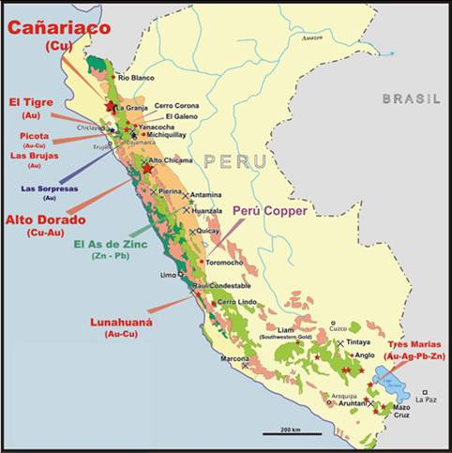
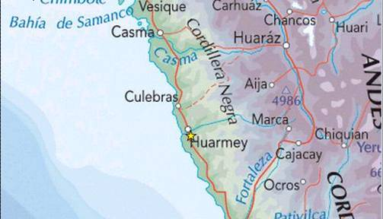
Transport Route for the Antamina Mine and the Port of Huarmey
Antamina Mine
Town of Huarmey

Slide 19
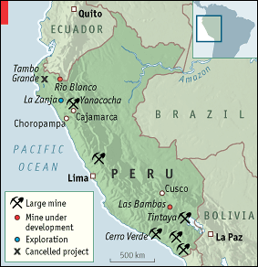
Yanacocha Mine in Relationship to Choropampa

Slide 20
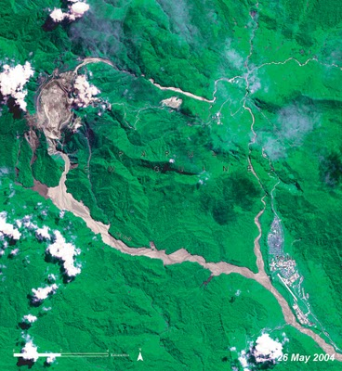
OK Tedi Downstream Impacts
Downstream Migration of Tailings and Flooding in the Fly River from the OK Tedi Mine

Slide 21
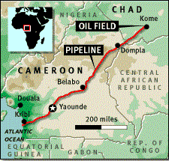
The Chad-Cameroon Pipeline
Source: MSNBC

Slide 22
STEPS TO A SUCCESSFUL CDA
MMSD (http://pubs.iied.org/pdfs/G00901.pdf? )in
“Breaking New Ground” identified three steps
to a successful CDA:
Company-Community Engagement
Integrated Impact-Assessment
Social, economic and environmental impacts on the local community
Creation of a Community Development Agreement
Needs to be evaluated on a case by case basis due to differing characteristics of each community

Slide 23
PANGUE EXPERIENCE – PEHUEN FOUNDATION
With all the best of intentions, some very problematic
results:
“Supporters” included, “opponents” excluded
“Welfare Handout” approach
“Friends” rewarded with benefits, “enemies” get nothing
Company control of decisions leads to human rights abuse allegations
See A Participatory Interim Evaluation of the Pehuen Foundation, Downing, T., International Finance Corporation, 1996
(www.ted-downing.com/Publications/Downing Peheun report English.pdf)

Slide 24
SETTING UP THE STRUCTURE
Not a “one time deal” but a durable governance mechanism that necessarily evolves over decades
Limits of company involvement
Identifying legitimate local leadership
Renewing leadership over time
Diversity of involvement
Vulnerable groups

Slide 25
DOING CDAs RIGHT
Requires doing a multiplicity of things well, and keeping some
principles in mind:
Clear objectives
Clear workable relationship to national government
Building and strengthening local government, not an alternative to local government
CDAs may be appropriate wherever (a) impacts are felt; or (b) opportunities exist for development
The process should start very early, perhaps with smaller proto-agreements of modest scale at exploration phase
Legitimacy and inclusivity of local leadership are absolute requirements
May need to develop long lived foundation structures to ensure ongoing benefits of development

Slide 26
ISSUES THAT MAY COME UP
Distribution of Revenue and Use
Gender Disparities
Support of Local Businesses
Employment and Skills Development
Conflict and Dispute Resolution Mechanisms
Community Health Initiatives
Integrated Planning for Mine Closure
Community Participation in Decision Making
Social Impact Assessment

Slide 27
ABOVE ALL
A need for sharing experience and learning in this area

Slide 28
THE CDA LIBRARY
Sustainable Development Strategies Group has
established a library of community development
agreements and materials relevant to how they are
negotiated, and the framework within which they
exist.
Please contribute to the library: kirsch@sdsg.org
Access the library at www.sdsg.org

Slide 29
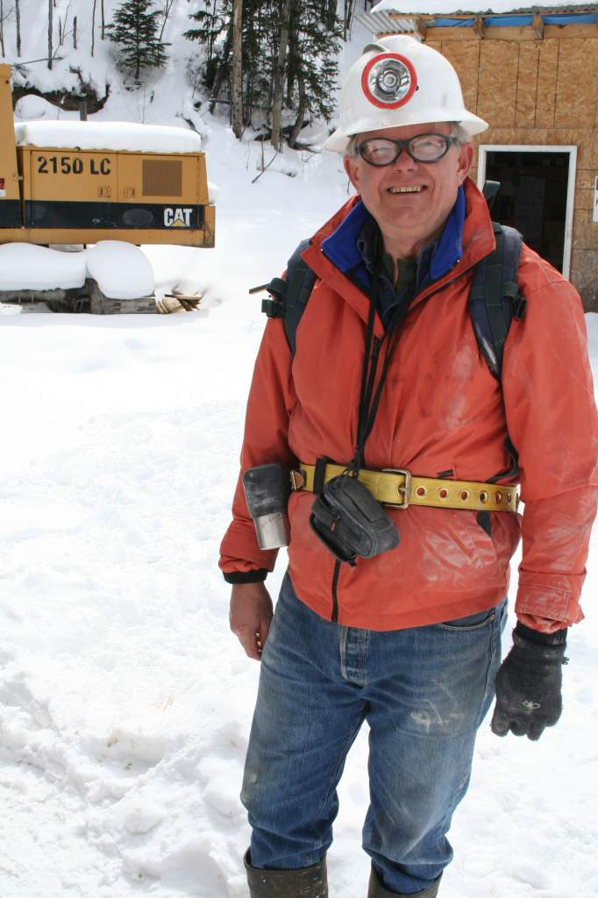
Thank You!
Sustainable Development Strategies Group
www.SDSG.org
And special thanks to Cassandra Kirsch for helping to organize this presentation
Sustainable Development Strategies Group is a Colorado not for profit
Corporation recognized as tax exempt under IRC section 501(c)(3)

